Slide 1
RxJS
Reacting to Actions
Lecture 7
By James(Jin) Wang
12/05/2021

Slide 2
Outline
Filtering a stream
Data stream vs. action stream
Subject and BehaviorSubject
Reacting to actions
Starting with an initial value

Slide 3
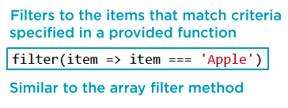
Filtering a stream
  RxJS Operator: filter

Slide 4
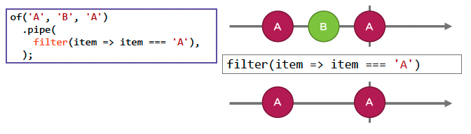
Filtering a stream
  Marble Diagram: filter

Slide 5
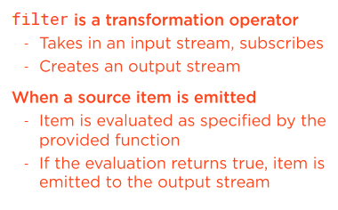
Filtering a stream
  RxJS Operator: filter
  Demo: filter hard-coded
  Demo: filter dropdown

Slide 6
Summary

Slide 7
Assignment

Slide 8
Self Study
  RxJS: The Big Picture
  https://app.pluralsight.com/library/courses/rxjs-big-picture

